Slide 1


JOB PORTAL SYSTEM
A PROJECT REPORT
Submitted by
SACHIN KUMAR A (2303811710421132) SHARUKESH DM (2303811710421140) SRINIVAS R (2303811710421157)
in partial fulfillment of requirements for the award of the course
CSB1303 – OBJECT ORIENTED ANALYSIS AND DESIGN
In
COMPUTER SCIENCE AND ENGINEERING
K. RAMAKRISHNAN COLLEGE OF TECHNOLOGY
(An Autonomous Institution, affiliated to Anna University Chennai and Approved by AICTE, New Delhi)
SAMAYAPURAM – 621 112
DECEMBER - 2025
i

Slide 2
K. RAMAKRISHNAN COLLEGE OF TECHNOLOGY (AUTONOMOUS)
SAMAYAPURAM – 621 112
BONAFIDE CERTIFICATE
Certified that this project report on “JOB PORTAL SYSTEM” is the bonafide work of SACHIN KUMAR A, SHAHRUKESH DM, SRINIVAS R who carried out the project work during the academic year 2024 - 2025 under my supervision.
SIGNATURE
SIGNATURE
Mr. R. RAJAVARMAN M.E., (PH.D.,)
Mrs. V. KALPANA, M.E.,
HEAD OF THE DEPARTMENT
SUPERVISOR
ASSISTANT PROFESSOR
Department of CSE
PROFESSOR
Department of CSE
K.Ramakrishnan College of Technology (Autonomous)
K.Ramakrishnan College of Technology (Autonomous)
Submitted for the viva-voce examination held on /12/2025…
Samayapuram–621112.
Samayapuram–621112.
INTERNAL EXAMINER
EXTERNAL EXAMINER
ii

Slide 3
DECLARATION
I declare that the project report on “JOB PORTAL SYSTEM” is the result of original work done by me and best of my knowledge, similar work has not been submitted to “ANNA UNIVERSITY CHENNAI” for the requirement of Degree of BACHELOR OF ENGINEERING. This project report is submitted on the partial fulfilment of the requirement of the completion of the course CSB1303 – OBJECT ORIENTED ANALYSIS AND DESIGN.
.
Signature
Place: Samayapuram Date:/12/2025
iii

Slide 4
ACKNOWLEDGEMENT
It is with great pride that I express my gratitude and in-debt to my institution “K.Ramakrishnan College of Technology (Autonomous)”, for providing me with the opportunity to do this project.
I glad to credit honourable chairman Dr. K. RAMAKRISHNAN, B.E., for having provided for the facilities during the course of my study in college.
I would like to express my sincere thanks to my beloved Executive Director Dr. KUPPUSAMY, MBA, Ph.D., for forwarding to my project and offering adequate duration in completing my project.
I would like to thank Dr. N. VASUDEVAN, M.Tech., Ph.D., Principal, who gave opportunity to frame the project the full satisfaction.
I whole heartily thanks to MR. R. RAJAVARMAN M.E., (PH.D.,) Head of the department, COMPUTER SCIENCE AND ENGINEERING for providing her encourage pursuing this project.
I express my deep expression and sincere gratitude to my project supervisor
Mrs. V. KALPANA, M.E., Department of COMPUTER SCIENCE AND ENGINEERING, for his incalculable suggestions, creativity, assistance and patience which motivated me to carry out this project.
I render my sincere thanks to Course Coordinator and other staff members for providing valuable information during the course.
I wish to express my special thanks to the officials and Lab Technicians of my departments who rendered their help during the period of the work progress.
iv

Slide 5
VISION OF THE INSTITUTION
To serve the society by offering top-notch technical education on par with global standards
MISSION OF THE INSTITUTION
Be a center of excellence for technical education in emerging technologies by exceeding the needs of the industry and society.
Be an institute with world class research facilities
Be an institute nurturing talent and enhancing the competency of students to transform them as all-round personality respecting moral and ethical values
VISION OF DEPARTMENT
To be a center of eminence in creating competent software professionals with research and innovative skills.
MISSION OF DEPARTMENT
M1: Industry Specific: To nurture students in working with various hardware and software platforms inclined with the best practices of industry.
M2: Research: To prepare students for research-oriented activities.
M3: Society: To empower students with the required skills to solve complex technological problems of society.
PROGRAM EDUCATIONAL OBJECTIVES
PEO1: Domain Knowledge
To produce graduates who have strong foundation of knowledge and skills in the field of Computer Science and Engineering.
PEO2: Employability Skills and Research
To produce graduates who are employable in industries/public sector/research organizations or work as an entrepreneur.
v

Slide 6
3. PEO3: Ethics and Values
To develop leadership skills and ethically collaborate with society to tackle real-world challenges.
PROGRAM SPECIFIC OUTCOMES (PSOs)
PSO 1: Domain Knowledge
To analyze, design and develop computing solutions by applying foundational concepts of Computer Science and Engineering.
PSO 2: Quality Software
To apply software engineering principles and practices for developing quality software for scientific and business applications.
PSO 3: Innovation Ideas
To adapt to emerging Information and Communication Technologies (ICT) to innovate ideas and solutions to existing/novel problems
PROGRAM OUTCOMES (POs)
Engineering students will be able to:
Engineering knowledge: Apply the knowledge of mathematics, science, engineering fundamentals, and an engineering specialization to the solution of complex engineering problems.
Problem analysis: Identify, formulate, review research literature, and analyze complex engineering problems reaching substantiated conclusions using first principles of mathematics, natural sciences, and engineering sciences
Design/development of solutions: Design solutions for complex engineering problems and design system components or processes that meet the specified needs with appropriate consideration for the public health and safety, and the cultural, societal, and environmental considerations
Conduct investigations of complex problems: Use research-based knowledge and research methods including design of experiments, analysis and interpretation of data, and synthesis of the information to provide valid conclusions
vi

Slide 7
Modern tool usage: Create, select, and apply appropriate techniques, resources, and modern engineering and IT tools including prediction and modeling to complex engineering activities with an understanding of the limitations
The engineer and society: Apply reasoning informed by the contextual knowledge to assess societal, health, safety, legal and cultural issues and the consequent responsibilities relevant to the professional engineering practice
Environment and sustainability: Understand the impact of the professional engineering solutions in societal and environmental contexts, and demonstrate the knowledge of, and need for sustainable development
Ethics: Apply ethical principles and commit to professional ethics and responsibilities and norms of the engineering practice.
Individual and team work: Function effectively as an individual, and as a member or leader in diverse teams, and in multidisciplinary settings.
Communication: Communicate effectively on complex engineering activities with the engineering community and with society at large, such as, being able to comprehend and write effective reports and design documentation, make effective presentations, and give and receive clear instructions.
Project management and finance: Demonstrate knowledge and understanding of the engineering and management principles and apply these to one’s own work, as a member and leader in a team, to manage projects and in multidisciplinary environments.
Life-long learning: Recognize the need for, and have the preparation and ability to engage in independent and life-long learning in the broadest context of technological change.
vii

Slide 8
ABSTRACT
The Job Portal System is an innovative, feature-rich web application designed to modernize and streamline the process of job searching, recruitment, and career development. Traditional job platforms often face challenges such as limited personalization, inefficient matching algorithms, and cumbersome application processes. This platform aims to resolve these issues by providing an intelligent, user-centric environment that supports seamless job discovery, personalized recommendations, and efficient application management. Built on modern web technologies, the platform incorporates a robust client-side architecture to manage user profiles, job listings, applications, and matching algorithms. Core functionalities include multi-tier user authentication, intelligent job matching based on skills and preferences, real-time notifications, comprehensive application tracking, and dynamic user engagement. The system leverages localStorage API with structured JSON schemas to ensure efficient data management and data integrity. To enhance security, the platform incorporates authentication and role-based access control, ensuring that only authorized users can perform sensitive actions such as posting jobs or accessing personal data. By fostering a dynamic and interactive environment, the platform enhances user experience and engagement while providing a reliable, secure, and efficient solution for modern job seeking and recruitment. This system exemplifies how web technologies can be utilized to create a flexible and scalable job portal experience, empowering both job seekers and employers to connect meaningfully and efficiently.
viii

Slide 9
ABSTRACT WITH POs AND PSOs MAPPING
CO 5 : DATABASE APPLICATIONS FOR SOLVING REAL-TIME PROBLEMS.
ABSTRACT | POs MAPPED | PSOs MAPPED
The Job Portal System is an innovative, feature-rich web | PO1 -3 PO2 -3 | PSO1 -3 PSO2 -3 PSO3 -3
application designed to modernize and streamline the process of job searching, recruitment, and career development. Traditional job platforms often face challenges such as limited
personalization, inefficient matching algorithms, and cumbersome application processes. This platform aims to resolve these issues by providing an intelligent, user-centric | PO3 -3 PO4 -3
environment that supports seamless job discovery, personalized recommendations, and efficient application management. Built on modern web technologies, the platform incorporates a robust client-side architecture to manage user profiles, job listings, applications, and matching algorithms. Core functionalities include multi-tier user authentication, intelligent job matching | PO5 -3 PO6 -3 PO7 -3 PO8 -3
based on skills and preferences, real-time notifications, comprehensive application tracking, and dynamic user engagement. The system leverages localStorage API with | PO9 -3 PO10 -3
structured JSON schemas to ensure efficient data management and data integrity. To enhance security, the platform incorporates authentication and role-based access control | PO11-3 PO12 -3
Note: 1- Low, 2-Medium, 3- High
ix

Slide 10
TABLE OF CONTENTS
TITLE
CHAPTER NO.
PAGE NO.
viii xii xiii
ABSTRACT
LIST OF FIGURES
LIST OF ABBREVATIONS
INTRODUCTION
1.1 Introduction about Domain 1
1
1.2 Problem Description 1
1.3 Objective of the Project 2
1.4 Scope of the Project 2
2
SYSTEM REQUIREMENT SPECIFICATION
2.1 Functional Requirements 3
2.2 Non Functional Requirements 3
2.3 Hardware Requirements 4
2.4 Software Requirements 4
2.5 User Characteristics 4
2.6 Constraints 5
3
ANALYSIS AND DESIGN
3.1 Use Case Model 6
3.2 Use Case Description 6
3.3 Activity Diagram 7
3.4 Class Diagram 7
3.5 Sequence Diagram 8
3.6 Collaboration Diagram 8
3.7 Component Diagram 9
3.8 Deployment Diagram 9
3.9 Package Diagram 10
3.10 Design Patterns Used ( GRASP, GoF) 10
x

Slide 11
TABLE OF CONTENTS
TITLE
CHAPTER NO.
PAGE NO.
4
IMPLEMENTATION
4.1 Module Description 11
4.2 Technology Description 11
4.3 Code Snippets 12
4.4 Screenshots 17
TESTING
5
5.1 Testing Strategy 20
5.2 Sample Test Cases 20
5.3 Test Results 21
6
CONCLUSION AND FUTURE ENHANCEMENT
6.1 Conclusion 22
6.2 Future Enhancement 22
7
REFERENCE 23
xi

Slide 12
LIST OF FIGURES
FIG NO.
TITLE
PAGE NO.
3.1 Use Case Model 6
3.3 Activity Diagram 7
3.4 Class Diagram 7
3.5 Sequence Diagram 8
3.6 Collaboration Diagram 8
3.7 Component Diagram 9
3.8 Deployment Diagram 9
3.9 Package Diagram 10
4.3.1 Index 17
4.3.2 Login 17
4.3.3 View Applicants 18
4.3.4 Search Job 18
4.3.5 Poster Jobs 19
4.3.6 Info 19
xii

Slide 13
LIST OF ABBREVATIONS
1NF
- First Normalization Form
PHP
- Hypertext Preprocessor
RDBMS
RBAC
2NF -
SQL -
3NF -
- Relational Data Base Management System
- Role-Baed Access Control
Second Normalization Form
Structured Query Language
Third Normalization Form
xiii

Slide 14
CHAPTER 1
INTRODUCTION
1.1 Introduction about Domain
The Job Portal System is a modern web-based platform designed to revolutionize job searching and recruitment processes. It connects job seekers and employers through an intelligent, user-friendly interface that simplifies employment connectivity. The system features advanced matching algorithms that personalize job recommendations based on skills, preferences, and profiles. Job seekers benefit from streamlined applications, real-time tracking, and personalized dashboards. Employers gain efficient tools for posting jobs, managing candidates, and accessing qualified talent. With secure role-based authentication, the platform ensures data protection for all users. Its responsive design provides seamless accessibility across all devices. Real-time notifications keep users engaged and informed throughout their journey. Built with HTML5, CSS3, and JavaScript, it demonstrates scalable client-side architecture. Ultimately, the platform creates a dynamic ecosystem that enhances employment opportunities for all stakeholders.
1.2 Problem Description
The current job market faces significant inefficiencies in connecting job seekers with suitable employment opportunities through traditional and digital platforms. Job seekers struggle with overwhelming numbers of irrelevant listings, generic search results, and cumbersome application processes that lack personalization. Employers face challenges in finding qualified candidates amidst unqualified applications and inefficient screening methods. Existing platforms often provide poor user experiences with complicated interfaces and limited mobile compatibility. The absence of intelligent matching algorithms leads to missed connections between qualified candidates and appropriate positions. Both job seekers and employers lack real-time communication channels and application tracking capabilities. Security concerns regarding personal data and fraudulent listings further complicate the digital recruitment landscape. These cumulative challenges result in prolonged hiring cycles, increased recruitment costs, and frustration for all parties involved in the employment process, creating a critical need for a more efficient, secure, and user- centric solution.
1

Slide 15
1.3 Objective of the Project
The primary objective of this Job Portal System is to develop a comprehensive web-based platform that effectively bridges the gap between job seekers and employers through an intuitive, efficient, and personalized digital ecosystem. The system aims to revolutionize traditional job search and recruitment processes by implementing intelligent matching algorithms that connect candidates with relevant opportunities based on their skills, experience, and preferences. The project focuses on establishing a robust user management system with secure authentication and role-based access control, safeguarding sensitive personal and professional information while maintaining data integrity. Another critical objective is to implement real-time notification systems and application tracking features that keep users informed and engaged throughout their job search or hiring journey. The platform strives to enhance user engagement through personalized job recommendations, interactive application processes, and comprehensive profile management tools. Additionally, the system aims to provide employers with efficient candidate screening and job posting capabilities, reducing recruitment timelines and improving hiring outcomes
1.4 Scope of the Project
The Job Portal System is a comprehensive web-based platform designed to transform the traditional job search and recruitment landscape. This innovative application connects job seekers with employers through an intelligent, user-friendly interface that streamlines the entire employment process. The system features a multi-tier authentication system supporting job seekers, employers, and administrators with customized dashboards and functionalities. At its core, the platform employs sophisticated matching algorithms that analyze user profiles, skills, and preferences to deliver personalized job recommendations. Job seekers benefit from advanced search capabilities, one-click applications, and real-time tracking of their submission status. Employers gain access to powerful tools for posting opportunities, managing applications, and discovering qualified candidates. Security is maintained through role-based access controls and secure data management practices. With features like email notifications and interactive user engagement tools, the system creates a dynamic ecosystem for career development and talent acquisition.
2
2

Slide 16
CHAPTER 2
SYSTEM REQUIREMENT SPECIFICATION
2.1 Functional Requirements
The functional requirements of the Job Portal System describe the essential operations the system must perform to support job seekers, employers, and administrators. The system must allow users to register, log in, and manage their profiles securely. Job seekers should be able to search for jobs using keywords or filters, view job details, and submit applications. Employers must be able to post new job openings, update or delete existing postings, and review applications received. The system should store and display application status so users can track their submissions. Administrative functions include monitoring user activities, verifying employer accounts, and ensuring data integrity across the portal. These functional requirements collectively define the core behavior needed for the platform to operate effectively.
2.2 Non Functional Requirements
The non-functional requirements focus on how the system should perform rather than what it should do. The Job Portal System must provide a fast and responsive user interface with minimal loading time to ensure a smooth experience. The portal should maintain high usability, offering intuitive navigation and clear feedback messages. It should be compatible across multiple devices and browsers through responsive design. Security is essential, requiring proper validation of user input, protection of sensitive data, and prevention of unauthorized access. Reliability must be ensured by preventing system crashes and providing stable performance even with multiple users. The system should also be maintainable so that future updates, enhancements, or integrations can be added easily. These non-functional requirements help ensure the system’s quality and performance. Security is essential, requiring proper validation of user input, protection of sensitive data, and prevention of unauthorized access. Reliability must be ensured by preventing system crashes and providing stable performance even with multiple users. The system should also be maintainable so that future updates, enhancements, or integrations can be added easily. These non-functional requirements help ensure the system’s quality and performance.
3

Slide 17
2.3 Hardware Requirements
The hardware requirements for running the Job Portal System are minimal since it is a web-based application. A standard computing device such as a laptop or desktop with at least 4 GB of RAM and a dual-core processor is sufficient for development and usage. Users need a device capable of running a modern web browser, which can include PCs, tablets, or smartphones. If implemented with a backend, the system may require a hosting server with adequate storage and processing capacity based on expected user load. Internet connectivity is essential for accessing the portal, uploading files such as resumes, and interacting with online resources. These requirements ensure smooth operation for both developers and end users.
2.4 Software Requirements
The software requirements include the tools, platforms, and technologies needed to develop and use the Job Portal System. For frontend development, HTML, CSS, Bootstrap, and JavaScript are required to design the interface and provide user interactivity. Any modern web browser such as Chrome, Firefox, or Edge is necessary for running and testing the application. Developers may use code editors like Visual Studio Code, Sublime Text, or Notepad++. If backend implementation is added, additional software such as PHP, Node.js, or Python, along with a database like MySQL or MongoDB, may be required. Supporting packages for version control (Git) and hosting (XAMPP, WAMP, or cloud services) can enhance development efficiency. These software tools provide a complete environment for building and deploying the system.
2.5 User Characteristics
Users of the Job Portal System include job seekers, employers, and administrators, each having different characteristics and levels of technical understanding. Job seekers may have basic computer skills and expect simple navigation while searching for jobs, creating profiles, and submitting applications. Employers typically possess moderate technical knowledge and require efficient tools for posting job openings and managing applicants. Administrators are usually more experienced users who handle system maintenance, data monitoring, and user verification. The system is designed to be intuitive so that users with minimal technical skills can operate it comfortably.
4

Slide 18
2.6 Constraints
The Job Portal System faces certain constraints that influence its design and implementation. Since the presented system is a frontend prototype, it does not include real-time backend processing or database storage, limiting its ability to handle live data and dynamic updates. The system depends on internet connectivity for full functionality, especially when integrated with backend services. Another constraint is browser compatibility, as the interface must adapt correctly to different screen sizes and devices. Security limitations exist in the absence of server-side validation or encryption. Time constraints during development may restrict the inclusion of advanced features such as AI recommendations or real-time notifications. These constraints highlight considerations that must be addressed in future development stages.
5

Slide 19
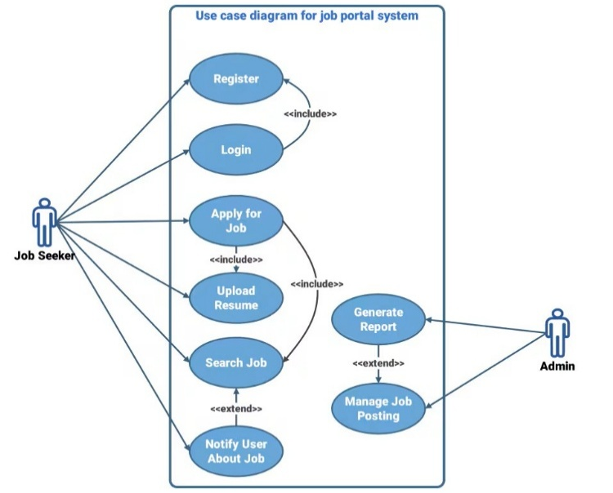
CHAPTER 3
ANALYSIS AND DESIGN
3.1 Use Case Model
3.2 Use Case Description
Each use case in the Job Portal System provides a detailed description of individual interactions between users and the system. For example, the “Job Search and Application” use case describes how a Job Seeker enters keywords, selects filters, browses results, views job details, and submits an application. The “Post Job Vacancy” use case explains how an Employer logs in, fills in job details, uploads company information, and publishes a job listing. The “User Registration and Authentication” use case outlines how the system validates user information, verifies credentials, and grants access. These use case descriptions present preconditions, postconditions, triggers, normal flows, and alternate flows to ensure that each system function is thoroughly analyzed and documented for further design stages. For instance, the job application process begins with the Job Seeker logging in, searching for opportunities, selecting a job, reviewing its details, uploading a resume, and confirming the application. Conditional branches such as “login success or failure,” “job available or not,” and “application already submitted or new” help visualize real-time decision-making. Similarly, the Employer workflow includes posting a job, entering job criteria, reviewing submissions, and managing existing listings. These activity flows help in understanding the coordination between front-end interactions and system-level processing.
6

Slide 20
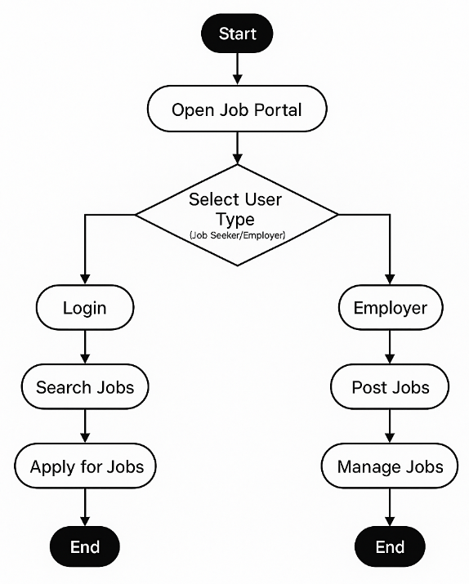
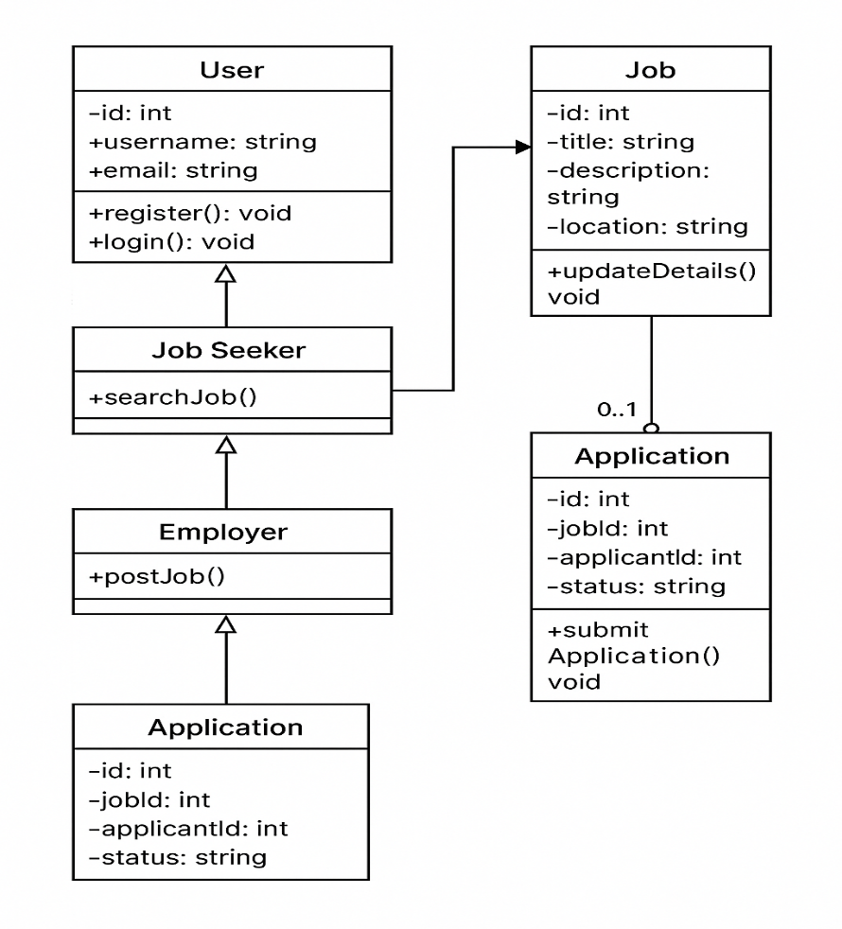
3.3 Activity Diagram
3.4 Class Diagram
7

Slide 21
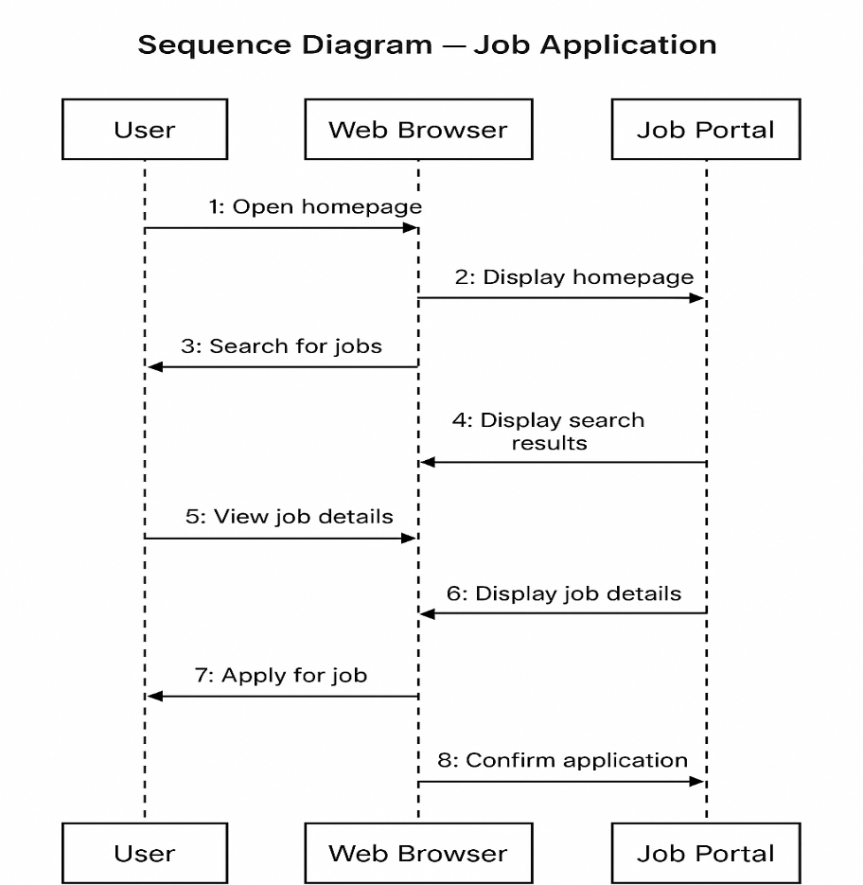
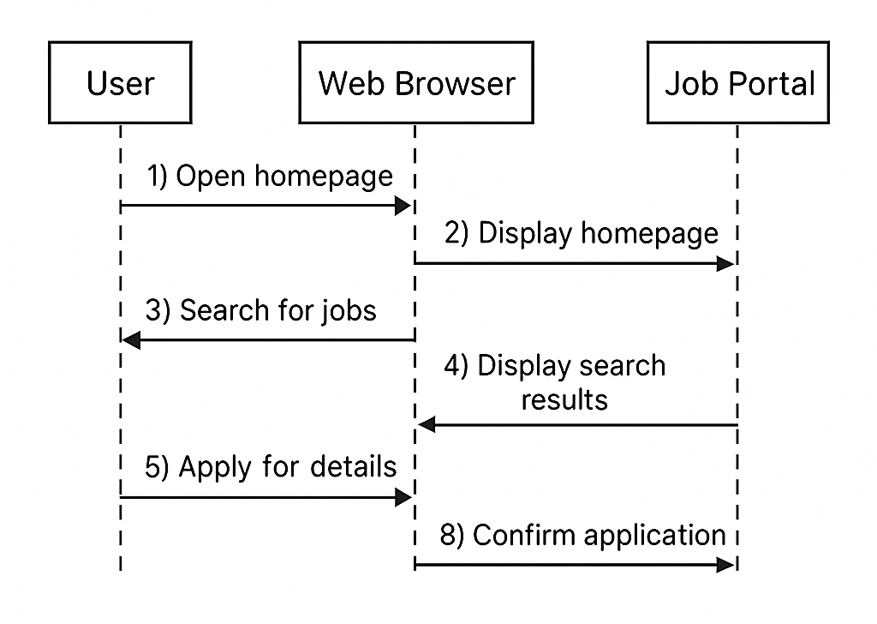
3.5 Sequence Diagram
3.6 Collaboration Diagram
8

Slide 22
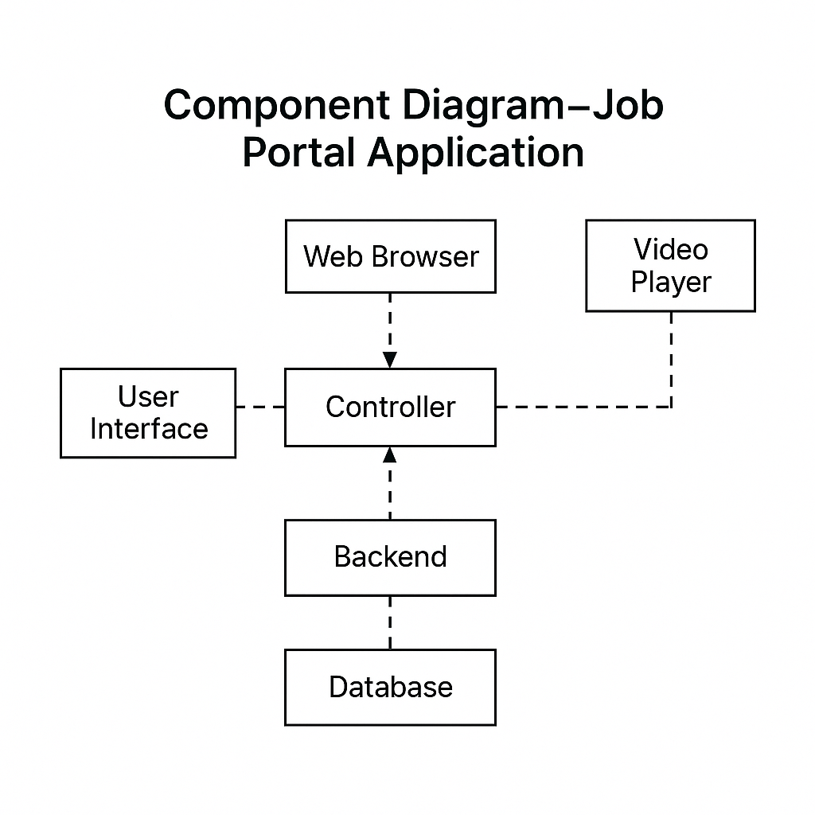
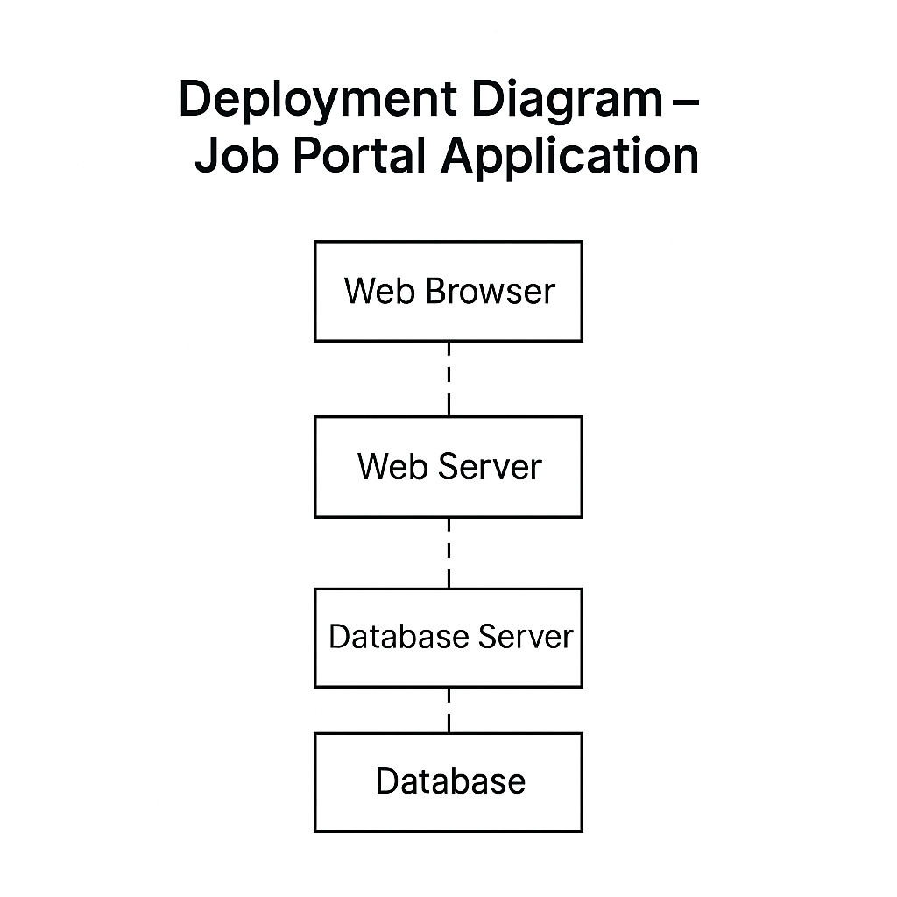
3.7 Component Diagram
3.8 Deployment Diagram
9

Slide 23
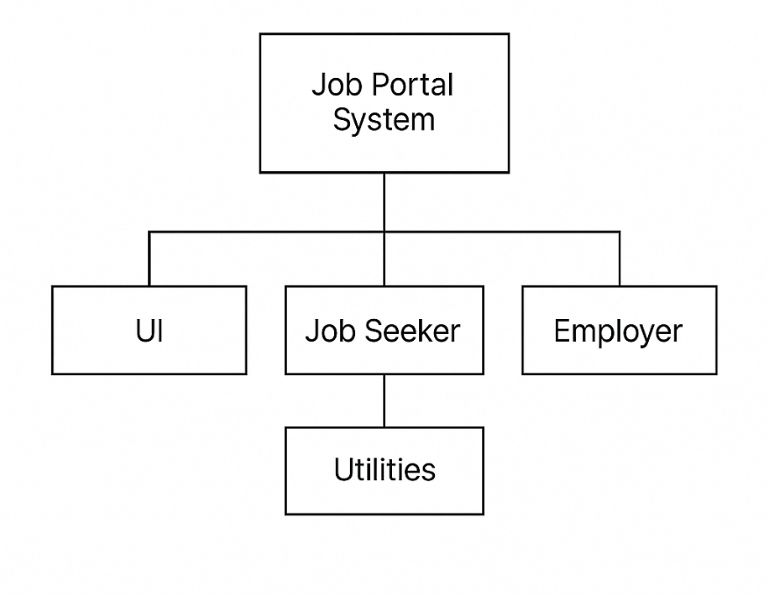
3.9 Package Diagram
3.10 Design Patterns Used ( GRASP, GoF)
In the Job Portal System, GRASP and GoF design patterns are applied to create a clean, maintainable, and scalable architecture. GRASP patterns such as Controller, Information Expert, Low Coupling, High Cohesion, and Polymorphism ensure proper responsibility assignment, reduced dependencies, focused class roles, and flexible behavior for different user types. GoF patterns further strengthen the design, with the Factory Method used to create user objects, Singleton managing a single database connection, Strategy enabling flexible job search filters, and Observer supporting user notifications. The MVC architectural pattern separates the system into Model, View, and Controller layers for better organization and easier maintenance. Together, these patterns improve system performance, flexibility, and future scalabilityGoF design patterns further strengthen the system, with the Factory Method Pattern used for creating user objects through a UserFactory to reduce tight coupling, the Singleton Pattern applied to the Database Connection Manager to ensure a single shared instance, and the Strategy Pattern enabling flexible job search filtering based on criteria such as location, salary, or experience. The Observer Pattern supports user notifications for job updates and application progress, enhancing dynamic interaction.. Together, these GRASP and GoF patterns contribute to a more scalable, robust, flexible, and efficient Job Portal System.
10

Slide 24
CHAPTER 4
IMPLEMENTATION
4.1 Module Description
The Job Portal System is organized into several functional modules that work together to provide a seamless experience for job seekers, employers, and administrators. The User Management Module handles registration, login, authentication, and profile management for all users. The Job Search Module allows job seekers to browse, filter, and view detailed job listings based on criteria such as location, role, and experience. The Job Posting Module enables employers to create, update, and remove job vacancies, ensuring that the portal always displays up-to-date opportunities. The Application Management Module manages application submissions, tracks application status, and allows employers to review applicants. The Admin Module oversees the entire platform by monitoring user activity, validating employer accounts, and ensuring system security. Together, these modules form a cohesive system that supports the end-to-end recruitment workflow.
4.2 Technology Description
The project is developed using a combination of web technologies that enable interactivity, responsiveness, and smooth navigation across pages. HTML is used for structuring the web pages, while CSS and Bootstrap enhance the visual presentation through layout styling, buttons, forms, and responsive components. JavaScript provides client-side interactivity, enabling form validation, dynamic content display, and interactive UI behavior. Image and video assets are included to enrich the user interface and improve user engagement. Although this prototype focuses on frontend development, it can be extended with backend technologies like PHP, Node.js, or Python Flask, along with a database such as MySQL or MongoDB for storing job postings, user profiles, and application data. These technologies together form a strong foundation for developing a fully functional job portal.
11

Slide 25
4.3 Code Snippets
User Profile
<!DOCTYPE html>
<html lang="en">
<head>
<meta charset="UTF-8" />
<meta name="viewport" content="width=device-width, initial-width, initial-scale=1.0"/>
<title>My Profile</title>
<link rel="icon" type="image/png" href="Images/icon.png">
<link href="https://cdn.jsdelivr.net/npm/bootstrap@5.3.7/dist/css/bootstrap.min.css" rel="stylesheet">
<script src="https://cdn.jsdelivr.net/npm/bootstrap@5.3.7/dist/js/bootstrap.bundle.min.js"></script>
</head>
<body>
<div class="background-overlay"></div>
<div class="content">
<div class="container">
<div class="row justify-content-center">
<div class="col-md-8">
<div class="profile-card">
<div class="profile-header">
<div class="avatar-upload-area">
<img id="profileAvatar" src="Images/default-avatar.png" alt="Profile Avatar" class="profile-avatar">
<input type="file" id="avatarFile" accept="image/*" style="display: none;">
<div class="overlay-text" onclick="document.getElementById('avatarFile').click()">
Change Photo
</div>
</div>
<h2 id="profileName">User Profile</h2>
<p id="profileRole" class="text-muted"></p>
</div>
<div id="jobSeekerProfile">
<h4>Personal Information</h4>
<div class="row mb-3">
<div class="col-md-6">
<label class="form-label">Full Name</label>
<input type="text" class="form-control" id="profileFullName">
</div>
<div class="col-md-6">
<label class="form-label">Email</label>
<input type="email" class="form-control" id="profileEmail" readonly>
</div>
</div>
12

Slide 26
<div class="mb-3">
<label class="form-label">Skills</label>
<input type="text" class="form-control" id="profileSkills" placeholder="Add skills separated by commas">
<div id="skillsDisplay" class="mt-2"></div>
</div>
<div class="mb-3">
<label class="form-label">Experience</label>
<textarea class="form-control" id="profileExperience" rows="3"></textarea>
</div>
<div class="mb-3">
<label class="form-label">Education</label>
<textarea class="form-control" id="profileEducation" rows="3"></textarea>
</div>
<div class="mb-3">
<label class="form-label">Preferred Job Types</label>
<input type="text" class="form-control" id="profileJobTypes" placeholder="Add preferred job types separated by commas">
<div id="jobTypesDisplay" class="mt-2"></div>
</div>
</div>
<div class="mb-3">
<label class="form-label">Company Description</label>
<textarea class="form-control" id="companyDescription" rows="4"></textarea>
</div>
</div>
<div class="d-flex justify-content-between mt-4">
<a href="index.html" class="btn btn-coffee">Back to Home</a>
<button id="saveProfile" class="btn btn-coffee">Save Profile</button>
</div>
</body>
</html>
13

Slide 27
Index
<!DOCTYPE html>
<html lang="en">
<head>
<meta charset="UTF-8" />
<meta name="viewport" content="width=device-width, initial-scale=1.0"/>
<title>Job Portal - Home</title>
<link rel="icon" type="image/png" href="Images/icon.png">
<link href="https://cdn.jsdelivr.net/npm/bootstrap@5.3.7/dist/css/bootstrap.min.css" rel="stylesheet">
<link rel="stylesheet" href="https://cdn.jsdelivr.net/npm/bootstrap-icons@1.10.5/font/bootstrap-icons.css">
<script src="https://cdn.jsdelivr.net/npm/bootstrap@5.3.7/dist/js/bootstrap.bundle.min.js"></script>
</head>
<body>
<div class="user-profile" id="userProfileContainer" style="display: none;">
<div class="position-relative">
<div id="userAvatarContainer" class="user-avatar-placeholder">
</div>
<span id="notificationBadge" class="notification-badge" style="display: none;">0</span>
</div>
<div id="userMenu" class="user-menu">
<a href="user-profile.html">My Profile</a>
<a href="applied-job.html">Applied Jobs</a>
<a href="job-recommendations.html">Recommended Jobs</a>
<a href="#" id="logoutBtn">Logout</a>
</div>
</div>
<div class="container-wrapper">
<div class="glass-card">
<a href="about.html" class="btn btn-outline-light btn-custom about-btn">About Us</a><br>
<h1>Welcome to Job Portal</h1>
<p>Turning <strong>dreams</strong> into <strong>careers</strong></p>
<a href="post-job.html" class="btn btn-light btn-custom me-3 user-company-link" style="display: none;">Post a Job</a>
<a href="view-applicants.html" class="btn btn-outline-light btn-custom user-company-link" style="display: none;">View Applicants</a>
<a href="admin-dashboard.html" class="btn btn-danger btn-custom user-admin-link" style="display: none;">Admin Dashboard</a>
</div>
</div>
</div>
</body>
</html>
14

Slide 28
Admin
<!DOCTYPE html>
<html lang="en">
<head>
<meta charset="UTF-8" />
<meta name="viewport" content="width=device-width, initial-scale=1.0"/>
<title>Admin Dashboard</title>
<link rel="icon" type="image/png" href="Images/icon.png">
<link href="https://cdn.jsdelivr.net/npm/bootstrap@5.3.7/dist/css/bootstrap.min.css" rel="stylesheet">
<link rel="stylesheet" href="https://cdn.jsdelivr.net/npm/bootstrap-icons@1.10.5/font/bootstrap-icons.css">
<script src="https://cdn.jsdelivr.net/npm/bootstrap@5.3.7/dist/js/bootstrap.bundle.min.js"></script>
</head>
<body>
<div class="background-overlay"></div>
<div class="content">
<div class="container">
<h2 class="text-white mb-4"><i class="bi bi-gear-fill me-2"></i>Admin Dashboard</h2>
<div class="alert alert-danger" id="authError" style="display: none;">
Access Denied. Only Administrators can view this page.
</div>
<ul class="nav nav-tabs" id="myTab" role="tablist">
<li class="nav-item" role="presentation">
<button class="nav-link active" id="jobs-tab" data-bs-toggle="tab" data-bs-target="#jobs" type="button" role="tab">All Posted Jobs</button>
</li>
<li class="nav-item" role="presentation">
<button class="nav-link" id="applications-tab" data-bs-toggle="tab" data-bs-target="#applications" type="button" role="tab">All Applications</button>
</li>
</ul>
<div class="tab-content admin-card" id="myTabContent">
<div class="tab-pane fade show active" id="jobs" role="tabpanel" aria-labelledby="jobs-tab">
15

Slide 29
<h4>All Jobs in the Portal</h4>
<table class="table table-striped" id="jobsTable">
<thead>
<tr>
<th>Job Title</th>
<th>Company</th>
<th>Location</th>
<th>Salary</th>
<th>Posted By (ID)</th>
</tr>
</thead>
<tbody>
</tbody>
</table>
</div>
<div class="tab-pane fade" id="applications" role="tabpanel" aria-labelledby="applications-tab">
<h4>All Submitted Applications</h4>
<table class="table table-striped" id="applicationsTable">
<thead>
<tr>
<th>Job Title</th>
<th>Applicant Name</th>
<th>Email</th>
<th>Phone</th>
<th>Applied At</th>
</tr>
</thead>
<tbody>
</tbody>
</table>
</div>
</div>
<div class="mt-4 text-center">
<a href="index.html" class="btn btn-coffee"><i class="bi bi-house-fill me-2"></i>Back to Home</a>
</div>
</div>
</div>
</body>
</html>
16

Slide 30
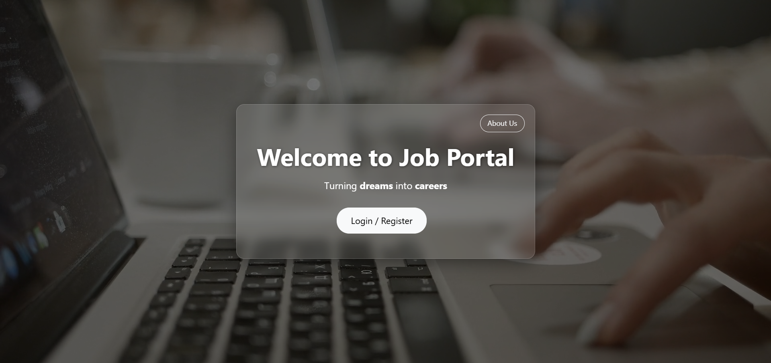
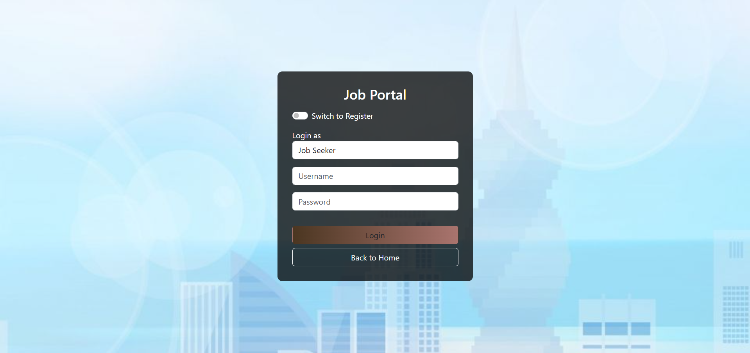
4.3 Screenshots
Fig.4.3.1 Index
Fig.4.3.2 Login
17

Slide 31
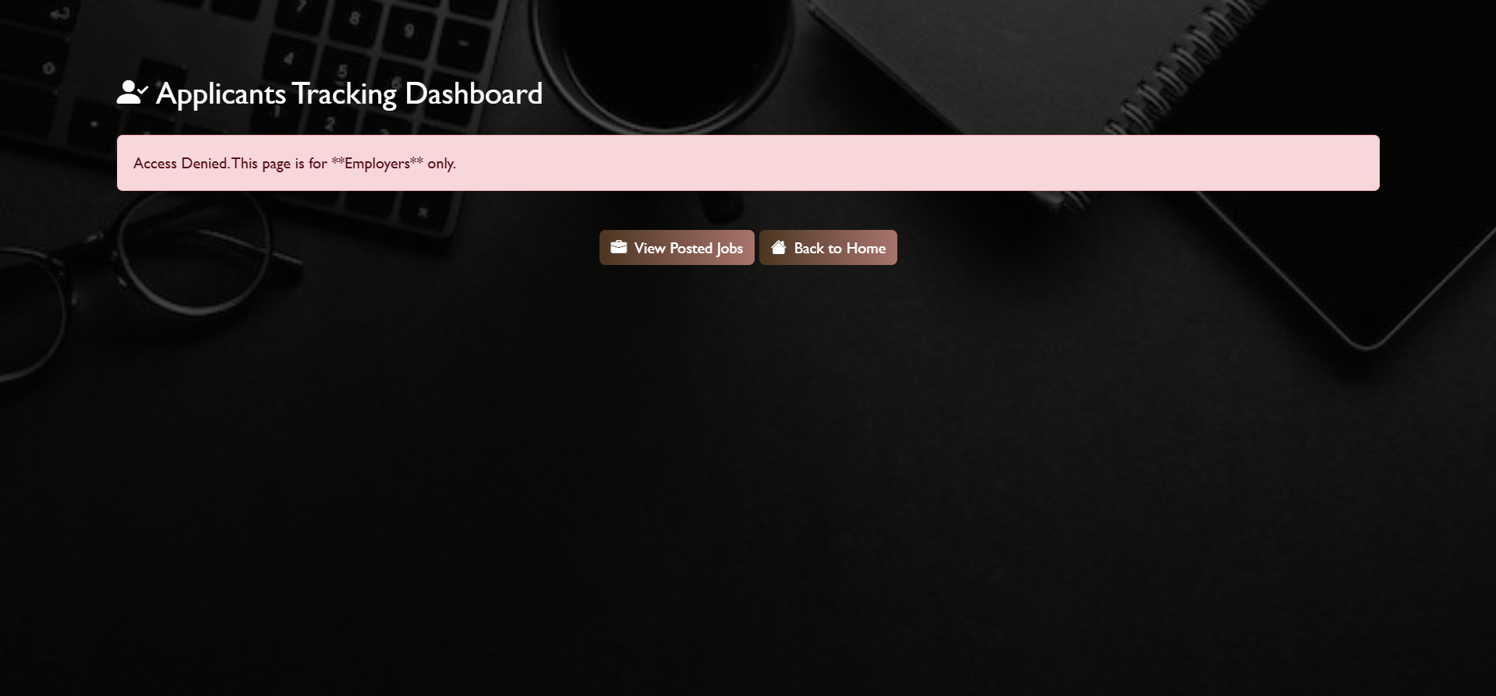
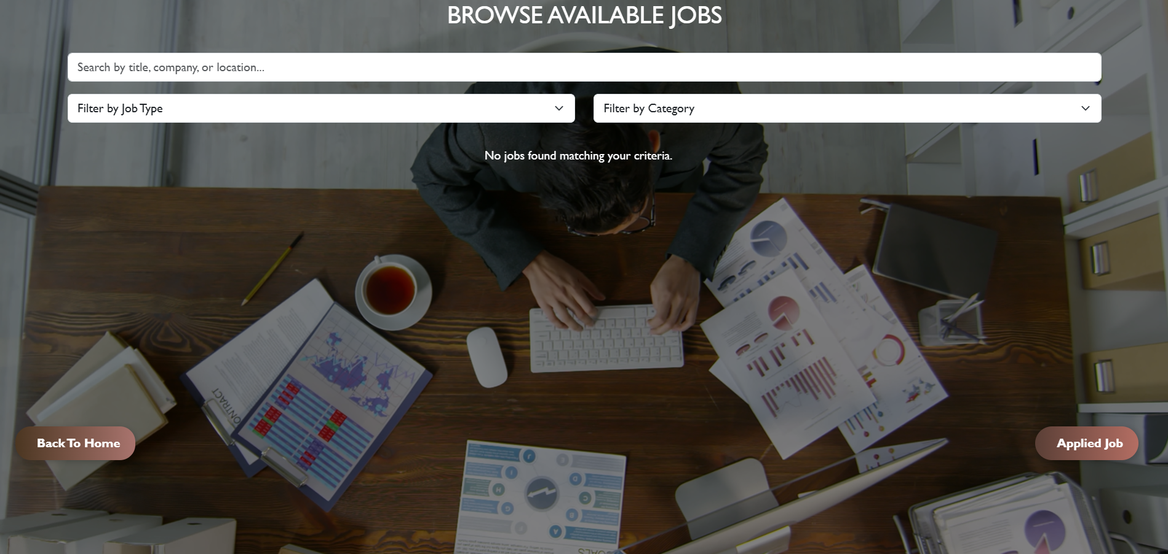
Fig.4.3.3 View Applicants
Fig.4.3.4 Search Job
18

Slide 32
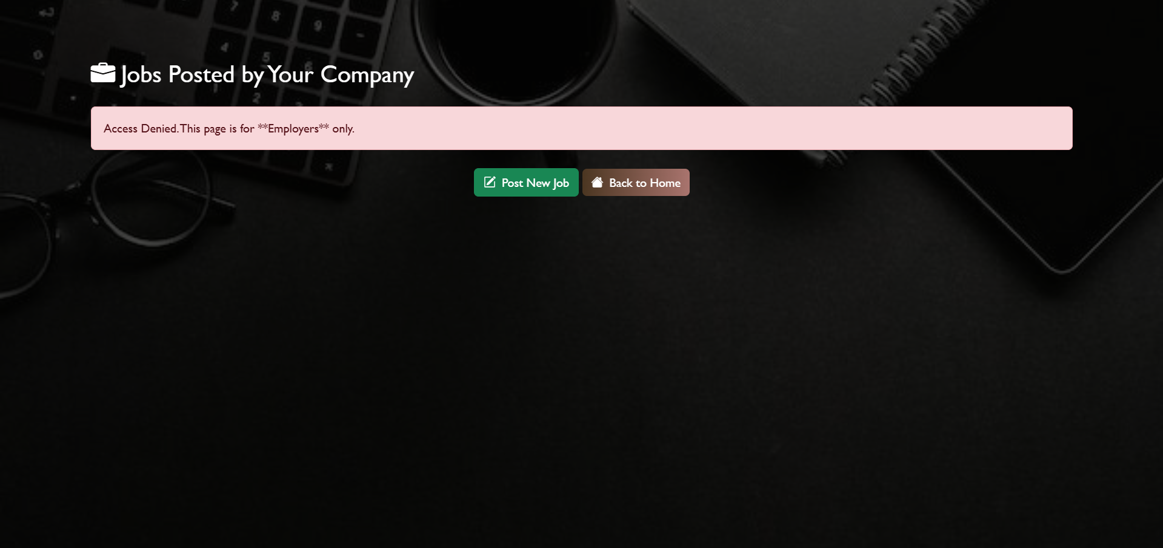

Fig.4.3.5 Posted Jobs
Fig.4.3.6 Info
19

Slide 33
CHAPTER 5
TESTING
5.1 Testing Strategy
The testing strategy for the Job Portal System focuses on ensuring that all modules function correctly, user interactions behave as expected, and the platform provides a smooth and error-free experience. The system is tested using a combination of functional testing, usability testing, and interface validation. Functional testing checks whether core activities—such as user registration, login, job search, job posting, and application submission—work according to requirements. Usability testing ensures that all pages load correctly, navigation is easy, and users can complete tasks without confusion. Form validation testing verifies that incorrect or incomplete inputs trigger proper error messages. Compatibility testing is performed on different browsers and screen sizes to ensure responsiveness. This comprehensive strategy helps identify defects early and ensures the system delivers a reliable and user-friendly experience.
5.2 Sample Test Cases
Sample test cases for the Job Portal System cover major functionalities such as user authentication, job searching, job posting, and job application. A typical test case for login includes entering valid credentials to verify successful authentication, entering wrong credentials to confirm error messages, and checking that empty fields are not accepted. Job search test cases include verifying search results for specific keywords, filtering jobs by category or location, and checking whether unavailable jobs display proper messages. Job posting test cases validate if employers can successfully upload job information, edit listings, or delete postings. Application submission test cases ensure that job seekers can apply only once, required files like resumes upload correctly, and application status updates are visible. These test cases confirm that every user action leads to the correct system response.
20

Slide 34
5.3 Test Results
The test results of the Job Portal System indicate that the major functionalities operated successfully, with most test cases passing on the first attempt and minor issues corrected through iterative debugging. User registration, login, and authentication performed reliably under different input conditions. Job search and filtering produced accurate results, while job posting and application submission modules handled data correctly without errors. Form validations worked as expected by preventing empty or incorrect inputs. Compatibility tests showed that the system displayed properly on multiple browsers and devices. After resolving small UI inconsistencies and validation issues, the final test cycle confirmed that the system meets the required functional and usability standards, demonstrating readiness for deployment as a frontend prototype.
21

Slide 35
CHAPTER 6
CONCLUSION AND FUTURE ENHANCEMENT
6.1 Conclusion
The Job Portal System successfully demonstrates how a digital recruitment platform can streamline the interaction between job seekers and employers through an organized, user-friendly interface. By applying Object-Oriented Analysis and Design principles, the system achieves a structured flow from requirements to implementation, ensuring clarity and modularity in its design. The use of UML diagrams, design patterns, and layered architecture helps maintain a strong foundation for scalability and maintainability. Core features such as user registration, job search, job posting, and application submission function smoothly, validating the effectiveness of the system’s design. As a frontend prototype, it provides a complete representation of how a real-world job portal operates and serves as a solid base for integrating backend services to transform it into a fully functional application.
6.2 Future Enhancement
The Job Portal System can be further enhanced by integrating backend technologies such as PHP, Node.js, or Python Flask, along with a database like MySQL or MongoDB to store user and job data securely. Additional features like AI-based job recommendations, automated resume screening, real-time chat between employers and applicants, and advanced search filters can significantly improve user experience. Implementing email or SMS notifications for application updates, employer verification systems, and secure authentication methods such as OTP or OAuth would strengthen reliability and security. Expanding the system into a mobile application and deploying it on cloud platforms would enhance accessibility and performance. These enhancements would transform the prototype into a full-scale, dynamic job portal capable of supporting a large number of users efficiently.
22

Slide 36
CHAPTER 7
REFERENCES
https://www.w3schools.com/
https://www.php.net/manual/en/
https://www.youtube.com/watch?v=OK_JCtrrv-c
https://www.youtube.com/watch?v=W6NZfCO5SIk
"Modern PHP: New Features and Good Practices" by Josh Lockhart
"Learning MySQL and MariaDB" by Russell J.T. Dyer
"JavaScript and JQuery: Interactive Front-End Web Development" by Jon Duckett .
"HTML and CSS: Design and Build Websites" by Jon Duckett
23

